Slide 1
Classification, Clustering, Frequent Pattern Mining
Presented By:
Maimoona Khilji

Slide 2
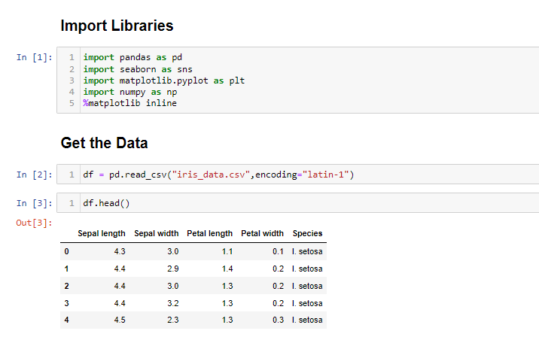

Slide 3
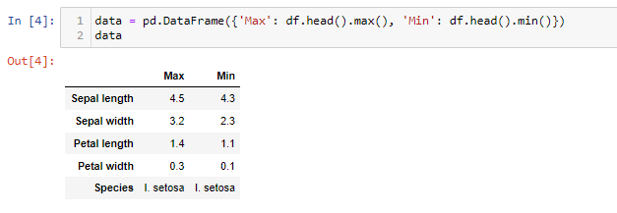

Slide 4
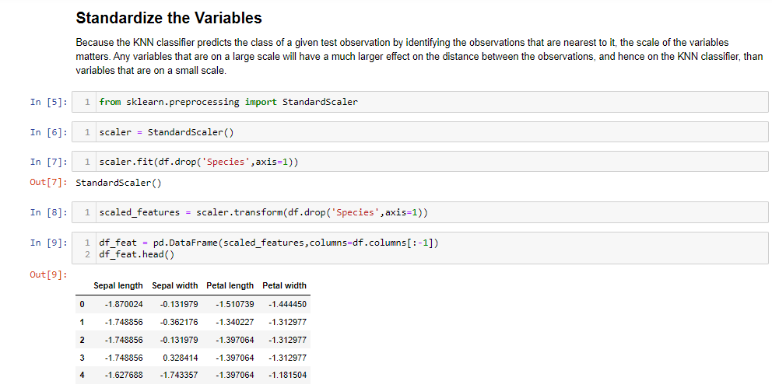

Slide 5
Supervised Algorithms

Slide 6
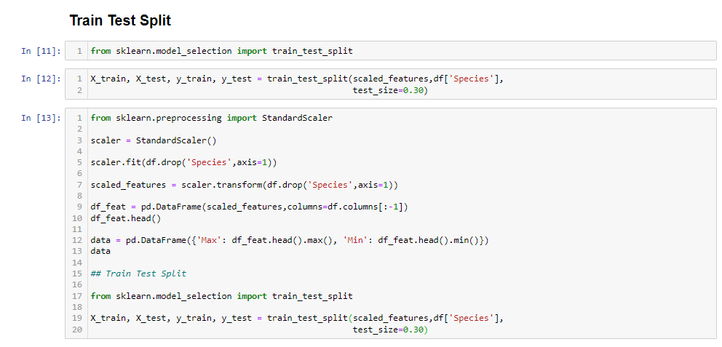

Slide 7
K-Nearest Neighbors
KNN is a classification algorithm. It is based on distance. It is known as lazy algorithms.

Slide 8
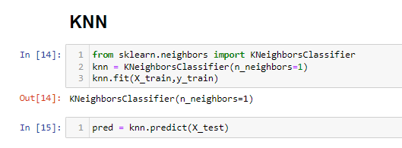

Slide 9
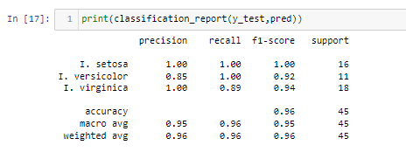

Slide 10
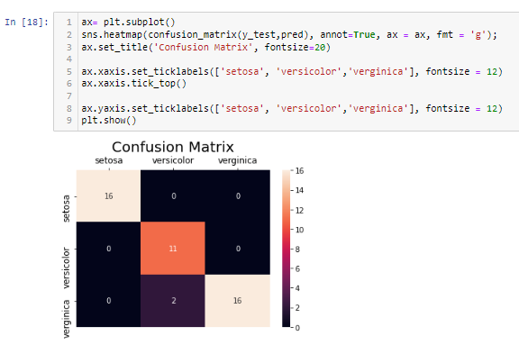

Slide 11
Naïve Bayes Algorithm
Bayesian classifier is a classification algorithm. It is based upon the famous Bayes theorem.

Slide 12
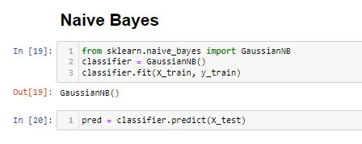

Slide 13
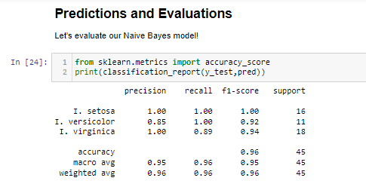

Slide 14
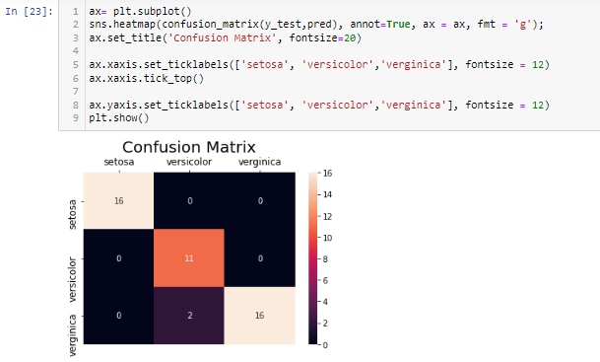

Slide 15
Unsupervised Algorithms

Slide 16
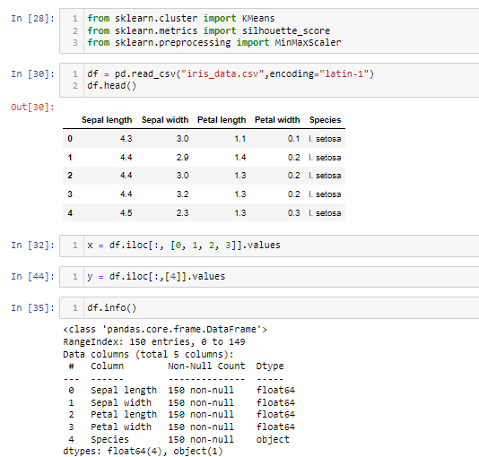

Slide 17
K-Means
The K-means clustering algorithm is used to find groups which have not been explicitly labeled in the data.

Slide 18
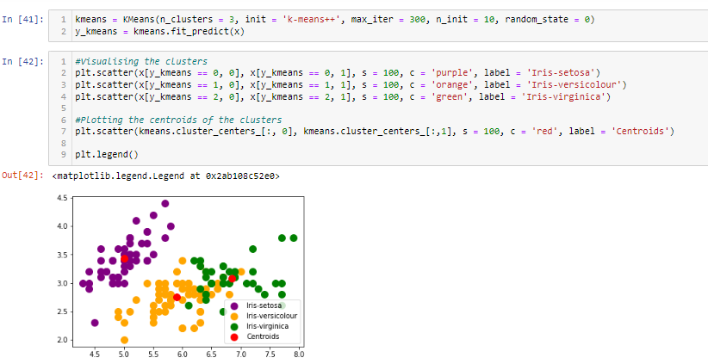

Slide 19
DB-Scan
Density-based spatial clustering of applications with noise (DBSCAN) is a well-known data clustering algorithm that is commonly used in data mining and machine learning.

Slide 20
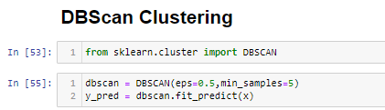

Slide 21
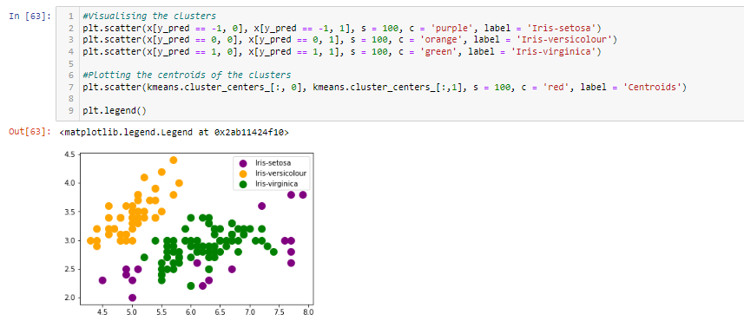

Slide 22
Frequent Pattern

Slide 23
FP-Growth
FP-Growth is an algorithm for extracting frequent itemsets with applications in association rule learning that emerged as a popular alternative to the established Apriori algorighm

Slide 24
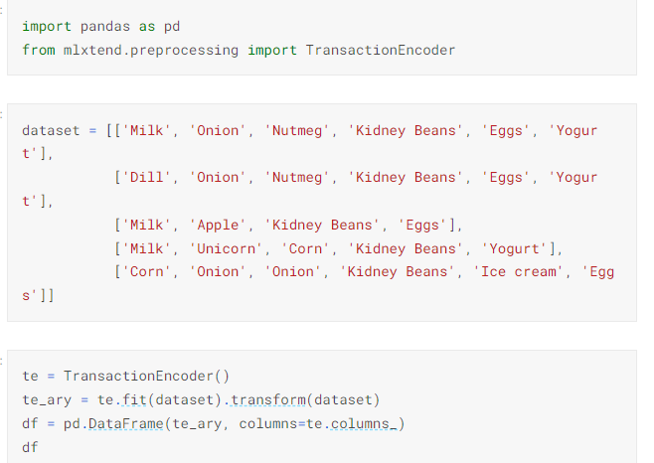

Slide 25
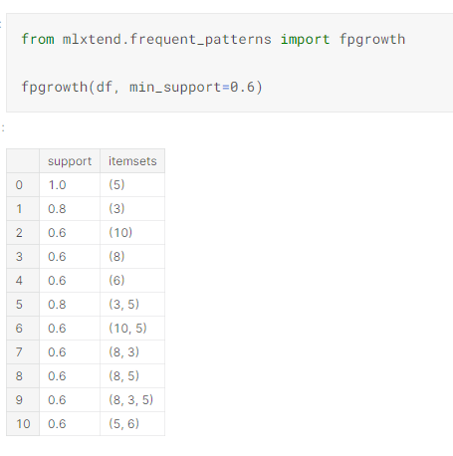

Slide 26
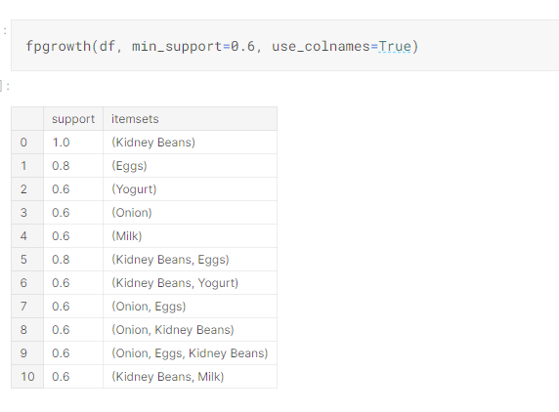

Slide 27
Apriori technique
Association rules analysis is a technique to uncover how items are associated to each other. There are three common ways to measure association.
Support. This says how popular an itemset is, it is number of times appear in total number of transaction. in other word we say frequency of item.
Confidence. This says how likely item Y is purchased when item X is purchased, expressed as {X -> Y}. This is measured by the proportion of transactions with item X, in which item Y also appears.
Lift. it is ratio of expected confidence to observed confidence. it is described as confidence of Y when item X was already known(x/y) to the confidence of Y when X item is unknown. in other words confidence of Y w.r.t. x and confiadnce of Y without X (means both are independent to each other).

Slide 28
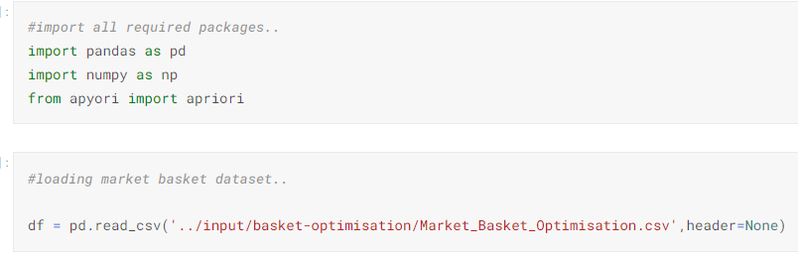

Slide 29
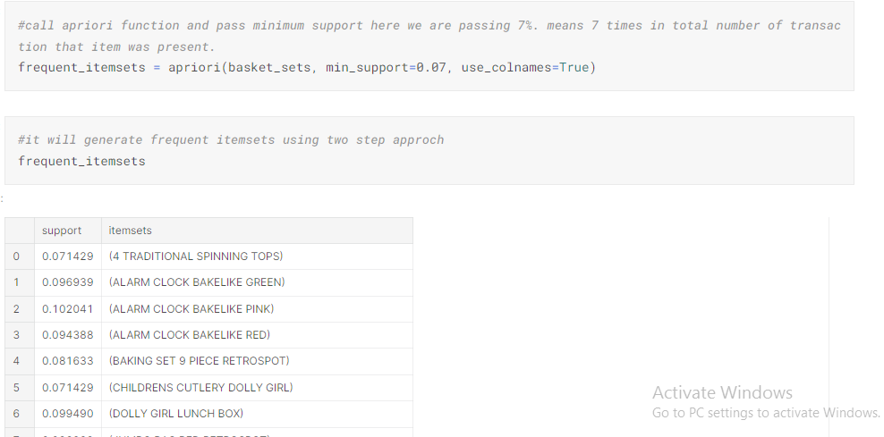

Slide 30
Thank You

